Slide 1

1 W E L C O M E A I E X P E R T
s
S r i r a m - I T E x p e r t
Y o u t u b e C h a n n e l : I n t e l l e c t S r i r a m

Slide 2
Course Intro – Artificial Intelligence Expert
Welcome AI Expert
Hearty Welcome to Artificial Intelligence Expert Course on my Youtube channel !
We will prepare you to become an AI expert in Python, Stats , Machine & Deep Learning
We will cover AI concepts with clear cut explanation and hands-on
We will see the latest trends and technology videos in AI with time to time updates
It's a one stop store where you can find the relevant information on latest technology
This course will be very long and interesting, so take your own time to plan accordingly
Basic IT Knowledge is necessary to begin with to grow the career in Artificial Intelligence
This course contains videos and detailed documentation in my Github
Once again warm welcome to AI aspiring career oriented professional to become an AI Expert !

Slide 3
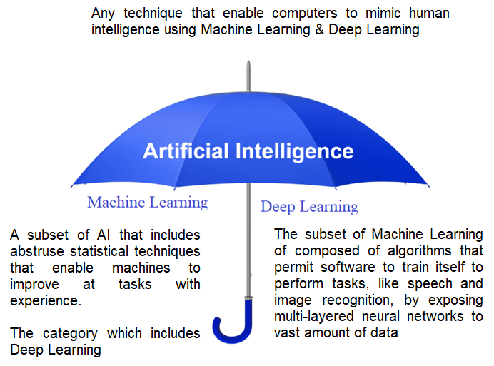
AI Umbrella
Welcome AI Expert
Deep Learning uses neural networks to simulate human like decision making

Slide 4
About me
Welcome AI Expert
I’m Sriram
Working as a consulting AI, Bigdata, Cloud architect.
Extensive experience in architecting solutions in the AI, Public Cloud since 2011, around the globe.
Deployed Predictive Modeling techniques including ML, advanced statistics to conceptualize scalable business solutions & Handling large dataset using DL
Trained and coached several professionals on advanced cloud technologies like Python, AI, ML, DL, AWS, Azure ,GCP & DevOps.
LinkedIn : https://www.linkedin.com/in/sriram-balasubramanian-374566166/
GitHub : https://github.com/intellectsriram

Slide 5
Sriram - Profile
Welcome AI Expert
An acclaimed professional with over 20 years of rich experience in AI, Cloud and product engineering.
As a senior architect I have worked on a gamut of technologies ranging from data analysis, AI, Cloud, Java Stack and high scale product engg
Strong hands-on experience in migrating several large-scale application from traditional stacks to cloud native applications
Experience in leading global project delivery for fortune 500 clients in architectural design, development, cloud-devops implementation with high-performance real-time solutions
Industry Supported: Automobile, Banking & Finance, Insurance , Healthcare , Retail, Logistics
Recognized for utilizing the expertise by understanding business requirements, building analytics environments, implementing information solutions, proposing new data models, completing Cloud & Business intelligence projects, and improving process flow by proposing IT solutions

Slide 6
Sriram - Skillset
Welcome AI Expert
Artificial Intelligence -> Deep Learning, Machine Learning, Python
Big Data –> Hadoop , Pig , Hive, Hbase, Sqoop, Oozie, Spark, Kafka, Cassandra
Public Cloud –> AWS, Azure , GCP, OCI
DevOps –> Git, Bitbucket, Jenkins, Ansible, Chef, Puppet, Docker, Kubernetes, Nagios
Oracle –> Java, Spring, Spring Boot, Microservices, Oracle DBA, MySQL DB, DBA
Microsoft –> . Net, SharePoint, SQL Server DBA
MEARN Stack –> Mongo DB, ExpressJS, Angular JS, React JS, Node.js
Blockchain –> Public: Ethereum, Private: Hyperledger, ICO
Soft Skills –> Collaborator, Motivator, Change Agent, Planner

Slide 7
Sriram - Certification’s
Welcome AI Expert
Technical
Aviatrix Multi Cloud Networking Associate (MCNA)
AWS Certified Solution Architect - Associate (SAA)
Google Cloud Certified Professional Cloud Architect (GCP)
Microsoft Azure Architect Technologies (MCP)
Oracle Certified Java Professional (OCJP)
Certified Professional in Python Programming (PCPP)
CCA Spark and Hadoop Developer (CCA)
Process
Project Management Professional (PMP)
Certified Scrum Professional (CSP-SM)
ICAgile Certified Professional in Agile Coaching (ICP-ACC)
SAFe 5 Certified Program Consultant (SPC 5), SAFe 5 Release Train Engineer (RTE)
SAFe Practitioner, Agiligist, Scrum Master, Advanced Scrum Master, Product Owner | Product Manager

Slide 8
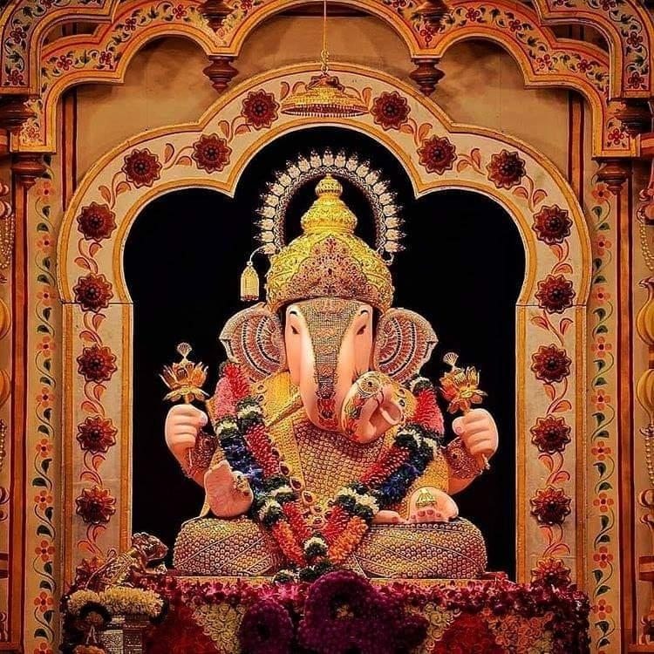

T h a n k Y o u !
I n t e l l e c t S r i r a m
Subscribed
LinkedIn : https://www.linkedin.com/in/sriram-balasubramanian-374566166/
GitHub : https://github.com/intellectsriram

